Slide 1
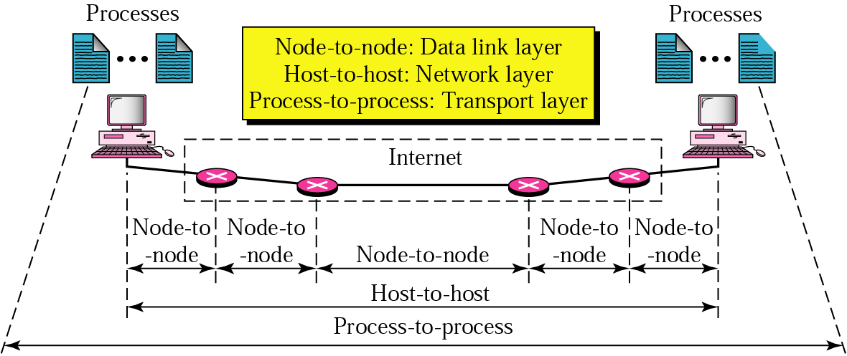
Topic 5: End-to-End Protocol
Notes:
Image Credit: Behroze Forouzan; Notes Credit: Peterson and Davie
The previous three topics covered in the lectures have described various technologies that can be used to connect together a collection of computers: direct links (including LAN technologies like Ethernet and token ring), packet-switched networks (including cell-based networks like ATM), and internetworks. The next problem is to turn this host-to-host packet delivery service into a process-to-process communication channel.
This is the role played by the transport level of the network architecture, which, because it supports
communication between the end application programs, is sometimes called the end-to-end protocol.
The end-to-end protocols will be next topic we’d cover in our Computer Networks Class.

Slide 2
Topic’s objectives
To learn about:
1 – The various connection states of TCP
2 – How TCP introduces flow-control?
3 – How TCP introduces reliability?
Notes:
Today we’d be seeing what are the primary objectives/ functions of an end-to-end transport layer protocol.
We’d also be seeing two common TCP/ IP end-to-end transport protocols that provide contrasting services: the first (UDP) provides a simple demultiplexing service and the other (TCP) provides a reliable byte stream service.

Slide 3
TCP = reliable byte stream
Recap
… emulated using TCP Segments
Sender
Byte 0
Byte 1
Byte 2
Byte 3
Byte 80
Segment sent when:
Segment full (Max Segment Size),
Not full, but times out, or
Pushed by application.
TCP Segment
TCP Segment
Byte 0
Byte 1
Byte 2
Byte 3
Byte 80
Receiver

Slide 4
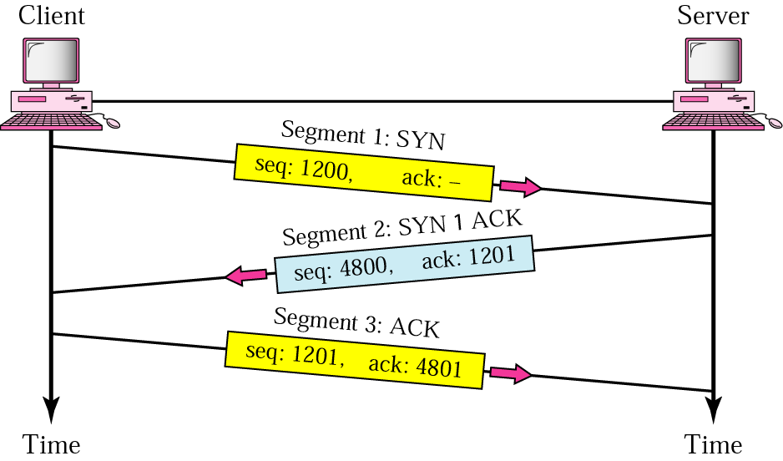
TCP connection establishment
Recap

Slide 5
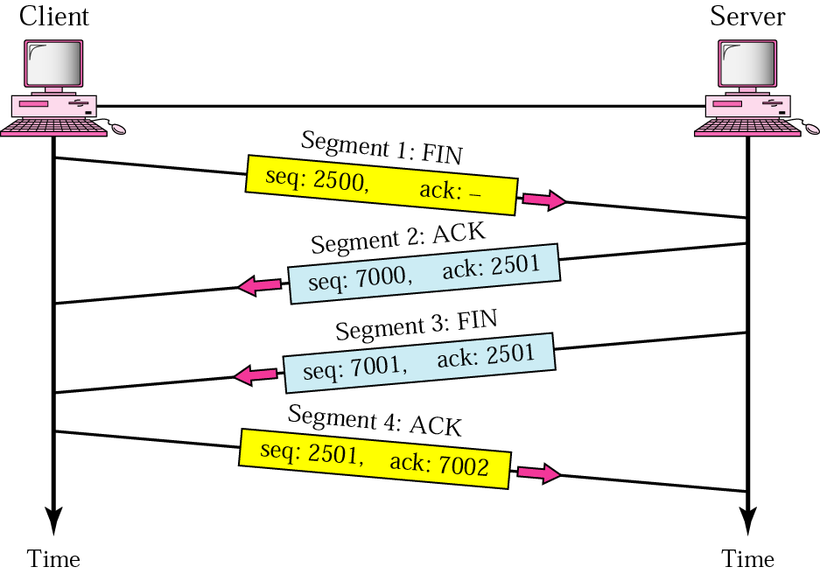
TCP connection termination
Recap

Slide 6
Connection States
of TCP
1
Notes:
During the life of a TCP connection, the TCP protocol running in each host makes transitions through various TCP states.
The figures above typical sequence of TCP states that are visited by the client TCP. The client TCP begins in the closed state. The application on the client side initiates a new TCP connection (by creating a Socket object as discussed in our lecture on Sockets). This causes TCP in the client to send a SYN segment to TCP in the server. After having sent the SYN segment, the client TCP enters the SYN_SENT sent. While in the SYN_STATE the client TCP waits for a segment from the server TCP that includes an acknowledgment for the client's previous segment as well as the SYN bit set to 1. Once having received such a segment, the client TCP enters the ESTABLISHED state. While in the ESTABLISHED state, the TCP client can send and receive TCP segments containing payload (i.e., application-generated) data.
Suppose that the client application decides it wants to close the connection. This causes the client TCP to send a TCP segment with the FIN bit set to 1 and to enter the FIN_WAIT_1 state. While in the FIN_WAIT state, the client TCP waits for a TCP segment from the server with an acknowledgment. When it receives this segment, the client TCP enters the FIN_WAIT_2 state. While in the FIN_WAIT_2 state, the client waits for another segment from the server with the FIN bit set to 1; after receiving this segment, the client TCP acknowledges the server's segment and enters the TIME_WAIT state. The TIME_WAIT state lets the TCP client resend the final acknowledgment in the case the ACK is lost. The time spent in the TIME-WAIT state is implementation dependent, but typical values are 30 seconds, 1 minute and 2 minutes. After the wait, the connection formally closes and all resources on the client side (including port numbers) are released.

Slide 7
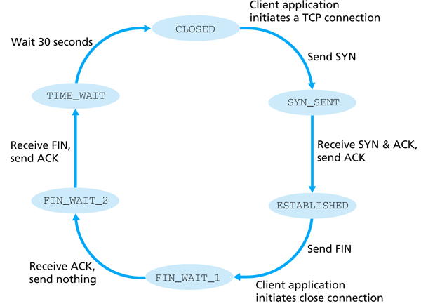
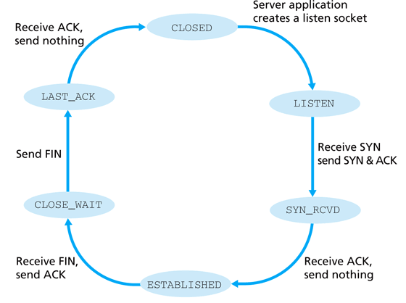
TCP State Transition Diagram
TCP client lifecycle
TCP server lifecycle
Notes:
During the life of a TCP connection, the TCP protocol running in each host makes transitions through various TCP states.
The figures above typical sequence of TCP states that are visited by the client TCP. The client TCP begins in the closed state. The application on the client side initiates a new TCP connection (by creating a Socket object as discussed in our lecture on Sockets). This causes TCP in the client to send a SYN segment to TCP in the server. After having sent the SYN segment, the client TCP enters the SYN_SENT sent. While in the SYN_STATE the client TCP waits for a segment from the server TCP that includes an acknowledgment for the client's previous segment as well as the SYN bit set to 1. Once having received such a segment, the client TCP enters the ESTABLISHED state. While in the ESTABLISHED state, the TCP client can send and receive TCP segments containing payload (i.e., application-generated) data.
Suppose that the client application decides it wants to close the connection. This causes the client TCP to send a TCP segment with the FIN bit set to 1 and to enter the FIN_WAIT_1 state. While in the FIN_WAIT state, the client TCP waits for a TCP segment from the server with an acknowledgment. When it receives this segment, the client TCP enters the FIN_WAIT_2 state. While in the FIN_WAIT_2 state, the client waits for another segment from the server with the FIN bit set to 1; after receiving this segment, the client TCP acknowledges the server's segment and enters the TIME_WAIT state. The TIME_WAIT state lets the TCP client resend the final acknowledgment in the case the ACK is lost. The time spent in the TIME-WAIT state is implementation dependent, but typical values are 30 seconds, 1 minute and 2 minutes. After the wait, the connection formally closes and all resources on the client side (including port numbers) are released.

Slide 8
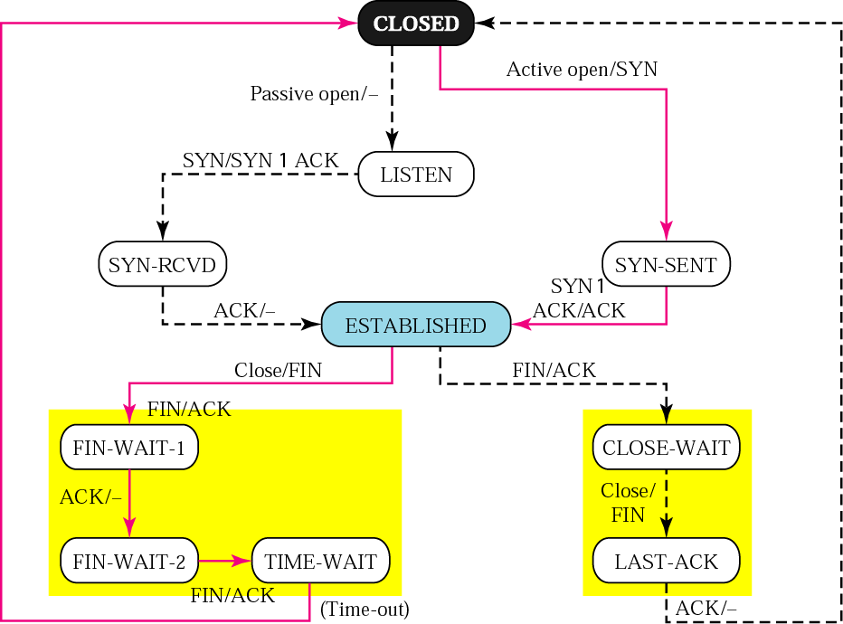
TCP State Transition Diagram
Server just received SYN from client
Active Opening of TCP connection
Active TCP close
Passive TCP close
Own FIN sent
First handshake’s ACK received
Notes:
State Explanation:
SYN_SEND Indicates active open. SYN_RECEIVED Server just received SYN from the client. ESTABLISHED Client received server's SYN and session is established. LISTEN Server is ready to accept connection. FIN_WAIT_1 Indicates active close. TIMED_WAIT Client enters this state after active close. CLOSE_WAIT Indicates passive close. Server just received first FIN from a client. FIN_WAIT_2 Client just received acknowledgment of its first FIN from the server. LAST_ACK Server is in this state when it sends its own FIN.
Opening a Connection: (CLOSED to ESTABLISHED)
TCP is complex enough that its specification includes a state transition diagram. A copy of this diagram is given in the figure above. This diagram shows only the states involved in opening a connection (everything above ESTABLISHED) and in closing a connection (everything below ESTABLISHED). Everything that goes on while a connection is open—that is, the operation of the sliding window algorithm—is hidden in the ESTABLISHED state.
TCP’s state transition diagram is fairly easy to understand. Each circle denotes a state that one end of a TCP connection can find itself in. All connections start in the CLOSED state. As the connection progresses, the connection moves from state to state according to the arcs. Each arc is labeled with a tag of the form event/action. Thus, if a connection is in the LISTEN state and a SYN segment arrives (i.e., a segment with the SYN flag set), the connection makes a transition to the SYN RCVD state and takes the action of replying with an ACK + SYN segment.
Notice that two kinds of events trigger a state transition: (1) a segment arrives from the peer (e.g., the event on the arc from LISTEN to SYN RCVD), or (2) the local application process invokes an operation on TCP (e.g., the active open event on the arc from CLOSE to SYN SENT). In other words, TCP’s state transition diagram effectively defines the semantics of both its peer-to-peer interface and its service interface.
When opening a connection, the server first invokes a passive open operation on TCP, which causes TCP to move to the LISTEN state. At some later time, the client does an active open, which causes its end of the connection to send a SYN segment to the server and to move to the SYN SENT state. When the SYN segment arrives at the server, it moves to the SYN RCVD state and responds with a SYN+ACK segment. The arrival of this segment causes the client to move to the ESTABLISHED state and to send an ACK back to the server. When this ACK arrives, the server finally
moves to the ESTABLISHED state. In other words, we have just traced the three-way handshake.
There are two things to notice about the connection establishment half of the state transition diagram:
First, if the client’s ACK to the server is lost, corresponding to the third leg of the three-way handshake, then the connection still functions correctly. This is because the client side is already in the ESTABLISHED state, so the local application process can start sending data to the other end. Each of these data segments will have the ACK flag set, and the correct value in the Acknowledgment field, so the server will move to the ESTABLISHED state when the first data segment arrives. This is actually an important point about TCP—every segment reports what sequence
number the sender is expecting to see next, even if this repeats the same sequence number contained in one or more previous segments.
Second, we must note the arcs that are not shown. Specifically, most of the states that involve sending a segment to the other side also schedule
a timeout that eventually causes the segment to be resent if the expected response does not happen. These retransmissions are not depicted in the state transition diagram. If after several tries the expected response does not arrive, TCP gives up and returns to the CLOSED state.
Closing a Connection: (ESTABLISHED to CLOSED)
Turning our attention now to the process of terminating a connection, the important thing to keep in mind is that the application process on both sides of the connection must independently close its half of the connection. If only one side closes the connection, then this means it has no more data to send, but it is still available to receive data from the other side. This complicates the state transition diagram because it must account for the possibility that the two sides invoke the close operator at the same time, as well as the possibility that first one side invokes close and then, at some later time, the other side invokes close. Thus, on any one side there are three combinations of transitions that get a connection from the ESTABLISHED state to the CLOSED state:
1) This side closes first: ESTABLISHED → FIN WAIT 1 → FIN WAIT 2 → TIME WAIT → CLOSED.
2) The other side closes first: ESTABLISHED → CLOSE WAIT → LAST ACK → CLOSED.
3) Both sides close at the same time: ESTABLISHED → FIN WAIT 1 → CLOSING → TIME WAIT → CLOSED.
The main thing to recognize about connection teardown is that a connection in the TIME WAIT state cannot move to the CLOSED state until it has waited for two times the maximum amount of time an IP datagram might live in the Internet (i.e., 120 seconds). The reason for this is that while the local side of the connection has sent an ACK in response to the other side’s FIN segment, it does not know that the ACK was successfully delivered. As a consequence, the other side might retransmit its As a consequence, the other side might retransmit its (TCP) FIN segment, and this second FIN segment might be delayed in the network. If the connection were allowed to move directly to the CLOSED state, then another pair of application processes might come along and open the same connection (i.e., use the same pair of port numbers), and the delayed FIN segment from the earlier incarnation of the connection would immediately initiate the termination of the later incarnation of that connection.

Slide 9
How TCP introduces flow-control
2
Notes:
TCP has an inbuilt flow-control feature that stops a sender from overwhelming the resources at the receiver by appropriately throttling the sending rate of the sender.
The flow-control feature is built into the sliding windows of TCP. As we shall see, the sliding window concept in TCP is very similar to what we’ve already studied for link-layer protocols earlier, the only main difference is that in TCP, the receiver advertises a window size and the sender is bound to follow it by sending only as many packets as allowed by the receivers window.

Slide 10
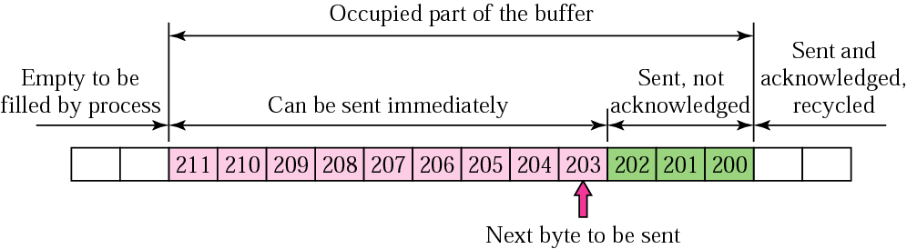
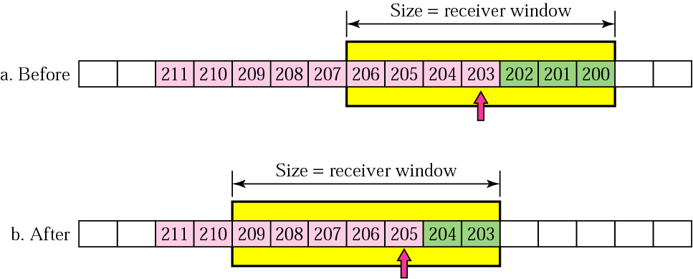
Sliding Windows – Sender’s end
Notes:
We are now ready to discuss TCP’s variant of the sliding window algorithm, which serves several purposes: (1) it guarantees the reliable delivery of data, (2) it ensures that data is delivered in order, and (3) it enforces flow control between the sender and the receiver.
TCP’s use of the sliding window algorithm is the same as we saw for point-to-point links (Chapter 2) in the case of the first two of these three functions. Where TCP differs from the earlier algorithm is that it folds the flow-control function in as well.
In particular, rather than having a fixed-size sliding window, the receiver advertises a window size to the sender. This is done using the AdvertisedWindow field in the TCP header. The sender is then limited to having no more than a value of AdvertisedWindow bytes of unacknowledged data at any given time. The receiver selects a suitable value for AdvertisedWindow based on the amount of memory allocated to the connection for the purpose of buffering data. The idea is to keep the sender from overrunning the receiver’s buffer.

Slide 11
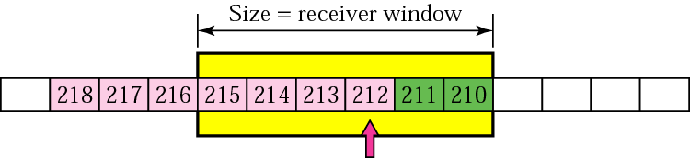
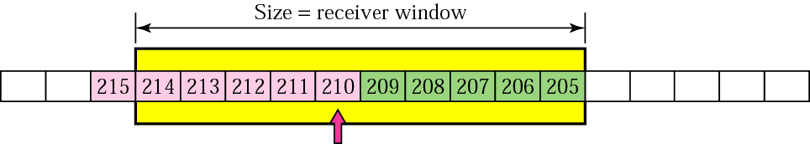
TCP Flow Control
Expanding/ Shrinking Windows
(based on receiver advertised window)
Sender’s window shrinks accordingly
Receiver advertises reduced window size
Sender’s sliding window shrinks if receiver’s advertised window reduces
Sender’s sliding window expands if receiver’s advertised window increases
Notes:
In the figures above, it is shown how the reduction/ increase in the receiver’s advertised window reduces/ or increases the window size at the sender.

Slide 12
How TCP introduces reliability
3
Notes:
During the life of a TCP connection, the TCP protocol running in each host makes transitions through various TCP states.
The figures above typical sequence of TCP states that are visited by the client TCP. The client TCP begins in the closed state. The application on the client side initiates a new TCP connection (by creating a Socket object as discussed in our lecture on Sockets). This causes TCP in the client to send a SYN segment to TCP in the server. After having sent the SYN segment, the client TCP enters the SYN_SENT sent. While in the SYN_STATE the client TCP waits for a segment from the server TCP that includes an acknowledgment for the client's previous segment as well as the SYN bit set to 1. Once having received such a segment, the client TCP enters the ESTABLISHED state. While in the ESTABLISHED state, the TCP client can send and receive TCP segments containing payload (i.e., application-generated) data.
Suppose that the client application decides it wants to close the connection. This causes the client TCP to send a TCP segment with the FIN bit set to 1 and to enter the FIN_WAIT_1 state. While in the FIN_WAIT state, the client TCP waits for a TCP segment from the server with an acknowledgment. When it receives this segment, the client TCP enters the FIN_WAIT_2 state. While in the FIN_WAIT_2 state, the client waits for another segment from the server with the FIN bit set to 1; after receiving this segment, the client TCP acknowledges the server's segment and enters the TIME_WAIT state. The TIME_WAIT state lets the TCP client resend the final acknowledgment in the case the ACK is lost. The time spent in the TIME-WAIT state is implementation dependent, but typical values are 30 seconds, 1 minute and 2 minutes. After the wait, the connection formally closes and all resources on the client side (including port numbers) are released.

Slide 13
TCP: Retransmissions
TCP uses Automatic Repeat Request (ARQ) for reliability
Packet
Packet
Packet
Timeout
Timeout
ACK
Timeout
ACK
Packet
Packet
Packet
ACK
Timeout
Timeout
Timeout
ACK
ACK
Packet lost
ACK lost
Duplicate Packet
Early timeout
Duplicate Packet
Notes:
Credit: Jennifer Ruxford

Slide 14
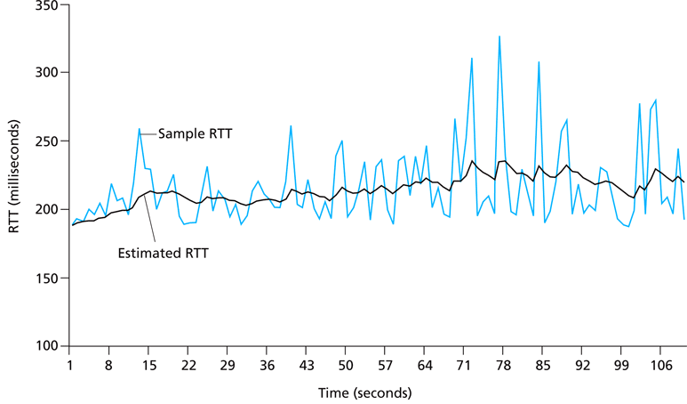
TCP: Adaptive Retransmission
= (1-α). Estimated RTT + α. Sample RTT
called Exponential Weighted Moving Average (EWMA)
Notes:
The sample RTT, denoted SampleRTT, for a segment is the time from when the segment is sent (i.e., passed to IP) until an acknowledgment for the segment is received. Each segment sent will have its own associated SampleRTT. Obviously, the SampleRTT values will fluctuate from segment to segment due to congestion in the routers and to the varying load on the end systems. Because of this fluctuation, any given SampleRTT value may be atypical. In order to estimate a typical RTT, it is therefore natural to take some sort of average of the SampleRTT values. TCP maintains an average, called EstimatedRTT, of the SampleRTT values. Upon receiving an acknowledgment and obtaining a new SampleRTT, TCP updates EstimatedRTT according to the following formula:
EstimatedRTT = (1-/alpha) . EstimatedRTT + /alpha . SampleRTT.
The above formula is written in the form of a programming language statement - the new value of EstimatedRTT is a weighted combination of the previous value of Estimated RTT and the new value for SampleRTT. A typical value of x is x = .1, in which case the above formula becomes:
EstimatedRTT = .9 EstimatedRTT + .1 SampleRTT.
Note that EstimatedRTT is a weighted average of the SampleRTT values. This weighted average puts more weight on recent samples than on old samples, This is natural, as the more recent samples better reflect the current congestion in the network. In statistics, such an average is called an exponential weighted moving average (EWMA). The word "exponential" appears in EWMA because the weight of a given SampleRTT decays exponentially fast as the updates proceed.

Slide 15
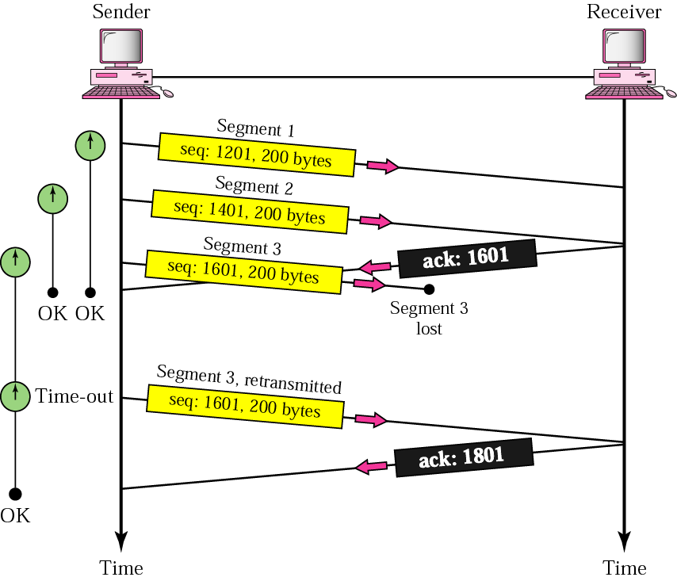
TCP: Lost Segment

Slide 16
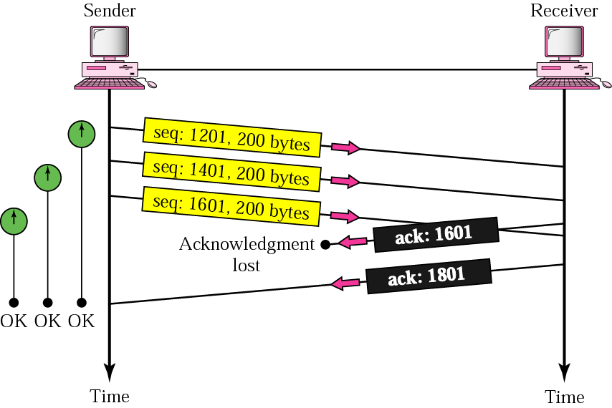
TCP: Lost Acknowledgement
Cumulative Acknowledgements

Slide 17

References
Section 5.2:
End-to-End Protocols
[P&D]

Slide 18
?
?
Questions/ Confusions?
?
Use the discussion forum at:
http://compnets.ning.com/
Credits/ Acknowledgement at:
http://sites.google.com/site/cse320site/

